Slide 1

Intrusion Detection System Based on Pattern Recognition
Paper Link: https://link.springer.com/article/10.1007/s13369-022-07421-0
Course: CSE 713
Sania Azhmee Bhuiyan
ID: 23266033
Team: 5 and 15
Course instructor: Annajiat Alim Rasel

Slide 2
BACKGROUND
Intrusion Detection System It is a security technology that monitors and analyzes network or system activities for malicious or suspicious behavior. The primary purpose of an IDS is to detect and respond to potential security threats, such as unauthorized access, malware activities, or other security policy violations.
Intrusion Detection System
Machine Learning and Pattern Recognition methods
Addressing the escalating challenges in network security due to the explosion of Internet of Things (IoT)

Slide 3
MOTIVATION
The paper aims to address the challenges in intrusion detection through a novel IDS leveraging machine learning and pattern recognition techniques.
CONTRIBUTION
The paper's contribution is the introduction of a two-layered IDS that first classifies network connections based on the service used and then identifies malicious activities using optimized feature detection.

Slide 4
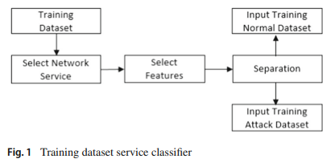
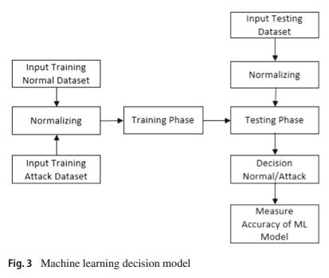
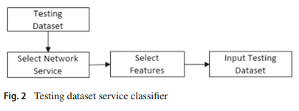
METHODOLOGY
The methodology involves creating two multivariate normal statistical models during the training phase: one for normal behavior and another for attack behavior. These models are then used in the testing phase to classify network activities into either normal or attack categories.

Slide 5
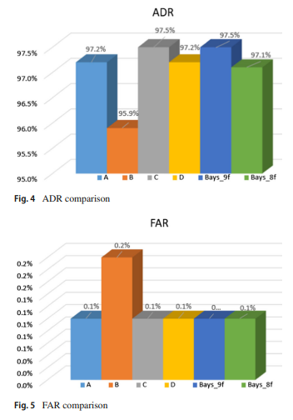
RESULTS
ADR, FAR (False Alarm Rate), Accuracy, and MCC (Matthews Correlation Coefficient):
The proposed IDS successfully achieves a Detection Rate (DR) of 97.5%, a False Alarm Rate (FAR) of 0.001, a Matthews Correlation Coefficient (MCC) of 95.7%, and an overall accuracy of 99.8% using just four features​

Slide 6
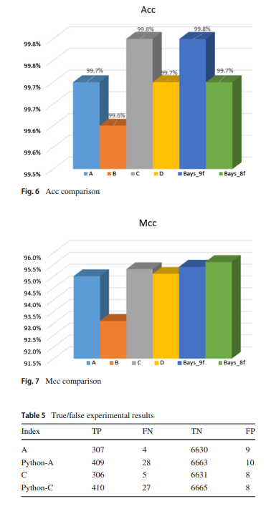
Performance Measurements
ADR (Attack Detection Rate) ranged between 93.6% to 97.5% for different implementations (A, Python-A, C, Python-C).
FAR (False Alarm Rate) was consistent at 0.1% for most implementations, except for Python-C which had a FAR of 0.2%.
Accuracy (Acc) was high across all implementations, ranging from 99.5% to 99.8%.
MCC (Matthews Correlation Coefficient) varied slightly among implementations, with values between 95.0% and 95.7%

Slide 7
First Limitation/Critique
A notable limitation of the study is the potential overfitting of the IDS model to specific network scenarios. This could limit the system's effectiveness in diverse or evolving network environments.
Second Limitation/Critique
The study may also face challenges in real-world applications due to the dynamic nature of cyber threats. The rapid evolution of malware and attack methodologies might render the two-layered approach less effective over time without continuous updates and learning.

Slide 8
CONCLUSION
The paper concludes that the proposed IDS exhibits superior performance in network intrusion detection compared to related systems. Using just four features, it achieves a detection rate (DR) of 97.5%, false alarm rate (FAR) of 0.001, Matthews correlation coefficient (MCC) of 95.7%, and an overall accuracy of 99.8%.

Slide 9
Thank You

